Slide 1
Cal Poly Pomona Micro-Internship Program
Olukemi Sawyerr, PhD
Associate Vice President
Office of Academic Innovation
Ericka Olguin
Director
Innovation Incubator
Jesus Bermudez
Micro-Internship Program Manager
Debbie Tanaka
Micro-Internship Program Coordinator

Slide 2

AGENDA
Introduction to Micro-Internships
Micro-Internships Program Design
Parker Dewey Model
Administrative Requirements
Q&A

Slide 3
WHAT ARE MICRO-INTERNSHIPS?
Short-term, paid work experience typically requiring 20-40 hours of work
Low-risk, requiring minimal on-boarding and suitable for college students with minimal instruction.
Serve as a valuable complement and supplement to traditional internships.
Year-round opportunities for on-demand project support, providing employers a chance to engage with and evaluate potential talent early, enhancing their pipeline for future interns and hires.

Slide 4
WHY MICRO-INTERNSHIPS?
New research shows more than 72% of internship hosts offer jobs to their students, increasing rates of employment upon graduation.
81% percent of students said internship experiences helped them decide to continue in their academic major or reevaluate their career goals
Traditional Internship opportunities are not always accessible.
Students struggle to break into the industry they want.

Slide 5
WHY MICRO-INTERNSHIPS?
Research shows that underrepresented minorities, females, and first-generation students are less likely to have had internship experiences as compared to their peers
These students are overrepresented in unpaid internships and underrepresented in paid internships
Financial burdens are significant barriers to participation in high quality internships as many first-generation and URM students choose to forego unpaid internships due to their need to maintain employment to cover educational and family expenses.

Slide 6
MICRO-INTERNSHIP PROGRAM DESIGN
Collaborate with academic departments to identify courses required of every student in the major.
Partner with faculty to design and embed micro-internship experiences in the identified courses.
Collaborate with industry and community partners to develop project-based micro-internship (20-40 hours per project).
Assess the micro-internship program to better understand its impact on student success, graduation, and retention rates and to ensure it is aligned with learning outcomes.

Slide 7
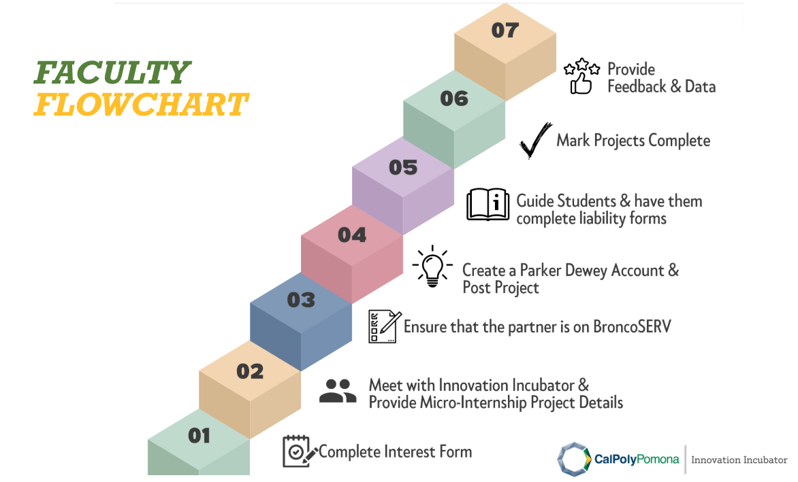
PARKER DEWEY MODEL

Slide 8



FACULTY & PARTNER PREPARATIONS
Outcomes & Deliverables:
Roster of Students
Purpose
Task
Due Date
Deliverable
Time & skills needed for this task
Onsite/Remote
Examples

Slide 9
QUESTIONS. COMMENTS.CONCERNS.
innovationinc@cpp.edu

